Slide 1
Contraception and HIV: update on the evidence and implications for programmes
Symposium: Sexual and reproductive health and HIV prevention
Jared Baeten MD PhD
Vice Chair, Department of Global Health
Professor, Departments of Global Health, Medicine, and Epidemiology
Director, UW/Fred Hutch Center for AIDS Research (CFAR)
Co-Director, International Clinical Research Center
University of Washington
Affiliate Investigator, Vaccine and Infectious Disease Division, Fred Hutchinson Cancer Research Center
Co-Principal Investigator, Microbicides Trials Network

Slide 2
Disclosures
I have received research funding for PrEP, ART for HIV prevention, microbicides, and contraception and HIV from the Bill & Melinda Gates Foundation, NIH, CDC, and USAID.
For some research studies, medication has been donated by Gilead Sciences and the International Partnership for Microbicides. I have served as an advisor for Gilead Sciences, Merck, and Janssen.
I have no other conflicts of interest.

Slide 3
Contraception and HIV: update on the evidence and implications for programmes
Symposium: Sexual and reproductive health and HIV prevention

Slide 4
Contraception and HIV: update on the evidence and implications for programmes
Symposium: Sexual and reproductive health and HIV prevention

Slide 5

ECHO
Results published The Lancet Online First:
http://www.thelancet.com/journals/lancet/article/PIIS0140-6736(19)31288-7/fulltext

Slide 6
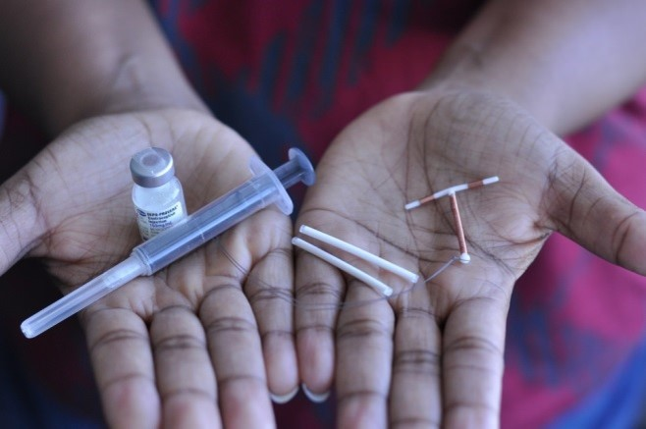

Why ECHO?

Slide 7
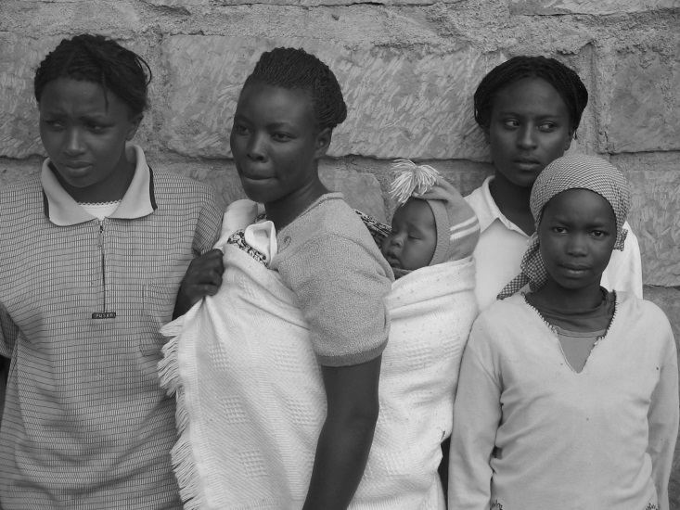
ECHO starting point
Women represent half of those living with HIV and the majority of new infections.
Safe and effective contraception is essential to the health and development of women, children and communities worldwide.

Slide 8
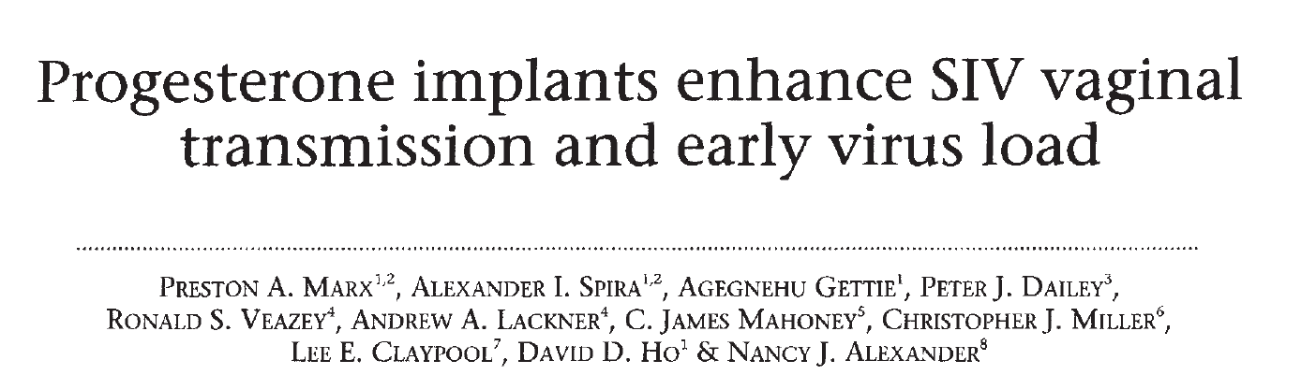
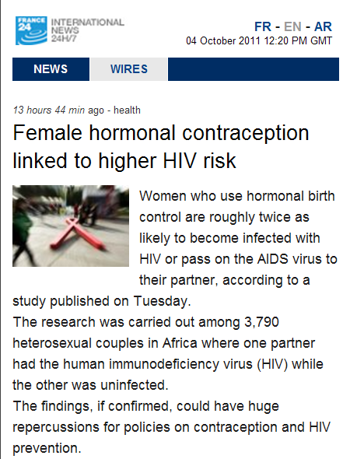
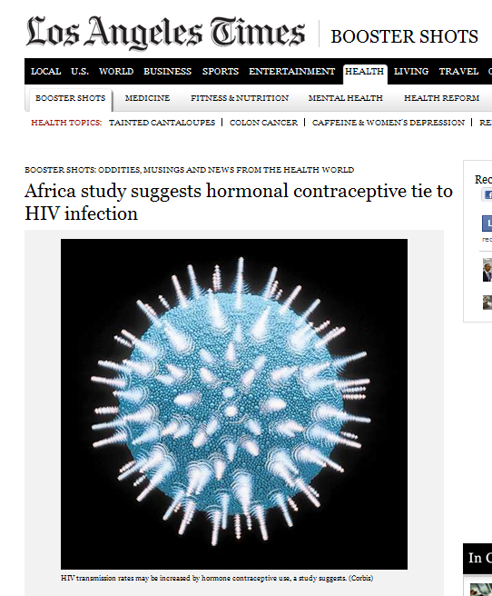
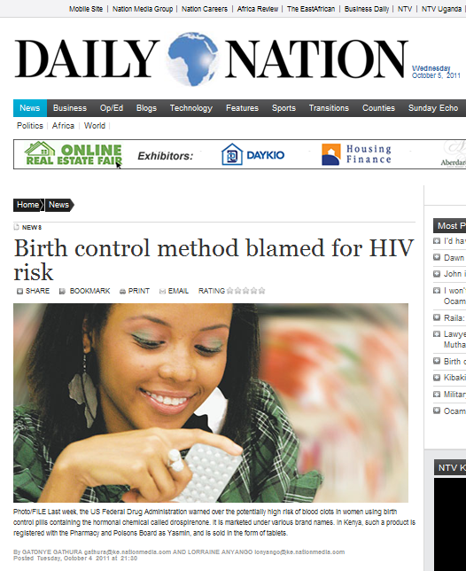
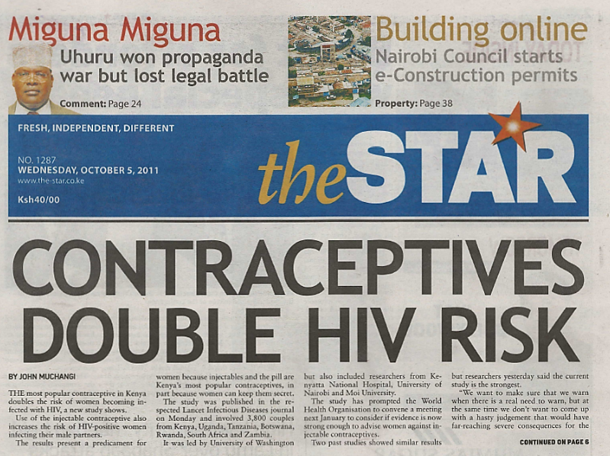
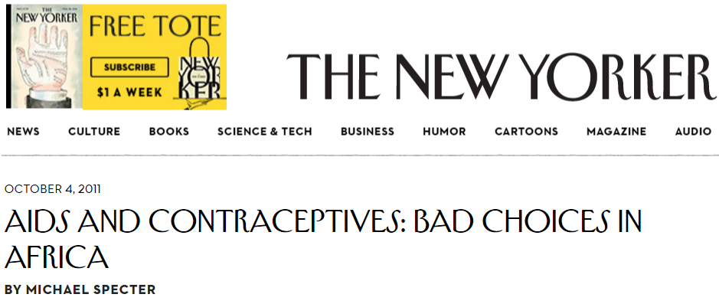
30 years of unresolved questions

Slide 9

Women’s right to know
Women need to know whether certain contraceptives increase their chances of getting HIV. This information will help them make informed choices about which contraceptive they want to use and which HIV prevention methods they need.
A randomised trial provides the highest quality evidence to enable women to make fully informed choices, inform clear counselling messages for clinicians, and offer guidance for policymakers and programs.

Slide 10
What was ECHO?

Slide 11
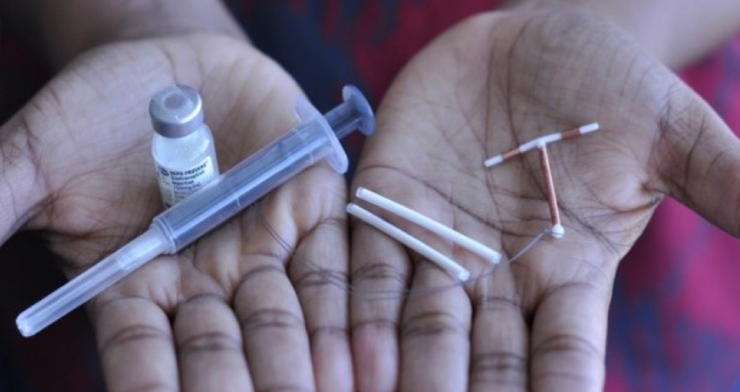
Design
Multicentre, open-label, randomised clinical trial comparing HIV incidence and contraceptive benefits in women using one of three highly-effective, licensed contraceptive methods:
  intramuscularly-delivered depot medroxyprogesterone acetate (DMPA-IM)
  a copper intrauterine device (IUD)
  and a levonorgestrel (LNG) implant
The primary objective was to compare HIV incidence among women randomised to DMPA-IM, a copper IUD, or an LNG implant.
Secondary outcomes included pregnancy, contraceptive method continuation, and adverse events.
The trial began in December 2015 and concluded in October 2018.

Slide 12
Statistical design
The trial was designed with 80% power to detect a 50% increase in the hazard of HIV for each contraceptive method compared to each of the others
DMPA-IM vs copper IUD
DMPA-IM vs LNG implant
copper IUD vs LNG implant
We chose a 50% increase in HIV risk based on formative work with stakeholders to determine a meaningful difference that would inform policy change.
Assumptions:
  underlying HIV incidence of 3.5 per 100 woman-years
  a two-sided type I error rate of 0.04 for each comparison
  10% loss to follow-up & 10% dilution of treatment effect due to method discontinuation

Slide 13
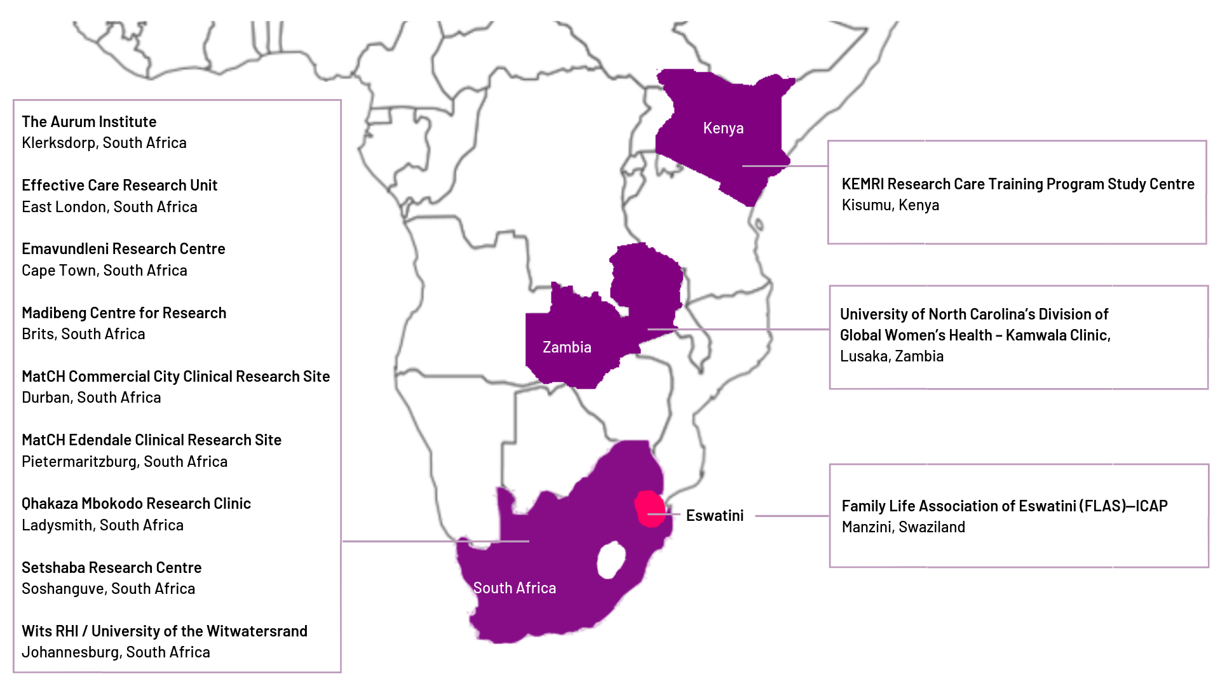
















ECHO consortium
The trial was undertaken by a multinational consortium in 12 sites in 4 countries: Eswatini (1), Kenya (1), South Africa (9), and Zambia (1)

Slide 14
Population and follow-up
Eligibility criteria: desired effective contraception, HIV seronegative, aged 16-35 years, agreed to use the assigned method for 18 months, able to provide written, informed consent.
Importantly, women were recruited for ECHO based on residing in geographies that had high risk of HIV but not individual characteristics of HIV risk, such as transactional sex, history of STIs, or self-reported high-risk behaviours.
Study follow-up occurred at one month then quarterly for up to 18 months, including HIV testing, contraceptive counselling, and safety monitoring.
  Women were counselled that they could at any time choose to discontinue their randomised method, choosing another trial method, a different contraceptive method, or no method.

Slide 15
What did ECHO find?

Slide 16
Enrolment and randomised assignment
7829 women ages 16-35 desiring contraception and willing to be randomised
Randomise
(1:1:1 ratio)
DMPA‒IM
(2609 women)
Copper IUD
(2607 women)
LNG implant
(2613 women)

Slide 17





Participant characteristics
Average age 23 (range 16-35), 63% <25 years of age
Most (81%) were not married & most (81%) had previously been pregnant at least once
Half did not use a condom with their last sex act, but only 7% reported >1 partner in the prior 3 months
STIs were common: 18% had C. trachomatis, 5% N. gonorrhoeae, and 38% HSV-2 (Deese LBPEB16)
PrEP was incorporated towards the end of the trial – 622 women used PrEP during follow-up (Beesham LBPEC25)

Slide 18
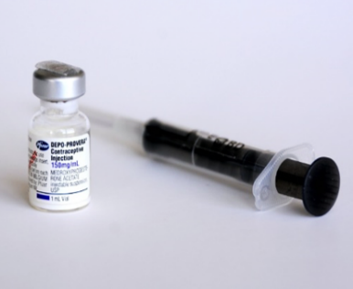
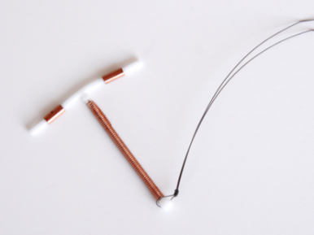
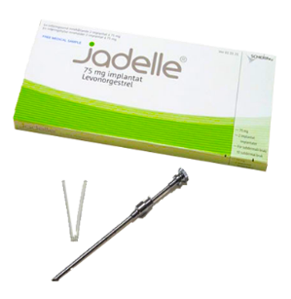
Follow-up
Retention was 94% at the final study visit
99+% accepted their randomised method at enrolment.
Participants used their methods for 92% of the time they were in the study
93.1%
DMPA-IM
89.0%
Copper IUD
93.7%
LNG implant

Slide 19


Rate of new HIV infections
In total, 397 of the 7829 women acquired HIV during the study
The overall rate of new HIV infections was 3.81% per year (95% CI 3.45-4.21).

Slide 20
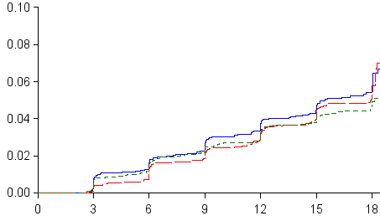
HIV incidence
Intention-to-treat analysis
 | DMPA-IM | Copper IUD | LNG Implant
# HIV infections | 143 | 138 | 116
HIV incidence, per 100 woman-years (95% CI) | 4.19 (3.54-4.94) | 3.94 (3.31-4.66) | 3.31 (2.74-3.98)
DMPA-IM vs. Copper IUD | DMPA-IM vs. LNG Implant | Copper IUD vs. LNG Implant
HR = 1.04 | HR = 1.23 | HR = 1.18
96% CI = 0.82-1.33 | 96% CI = 0.95-1.59 | 96% CI = 0.91-1.53
p = 0.72 | p = 0.097 | p = 0.19
Subgroup analyses, including causal methods, had similar findings (also see Palanee-Phillips LBPEC23)

Slide 21
Pregnancy and safety
Pregnancy rates were low, in all three groups, and most pregnancies (71%) occurred among women who had previously discontinued their randomised method. (Onono MOAX0103LB)
Adverse events that resulted in method discontinuation were relatively uncommon (7% of women overall) and more common among women randomised to the copper IUD or LNG implant compared to DMPA-IM
Perfect use analysis
 | DMPA-IM | Copper IUD | LNG Implant
# Pregnancies | 18 | 31 | 21
Pregnancy incidence, per 100 woman-years | 0.61 | 1.06 | 0.63
 | DMPA-IM | Copper IUD | LNG Implant
SAE | 49 (1.88%) | 92 (3.53%) | 78 (2.99%)
AE resulting in method discontinuation | 109 (4.18%) | 218 (8.36%) | 226 (8.65%)

Slide 22
How does this come together?

Slide 23
Summary
This well-conducted, multi-country randomised trial measured HIV incidence among African women assigned to one of three highly-effective contraceptive methods.
Acceptance of randomised method, contraceptive continuation, and retention were very high across all methods.
HIV incidence was high for all three groups. The trial did not find a substantial difference in HIV risk among the methods evaluated, and all methods were safe and highly effective for pregnancy prevention.

Slide 24
Contraception and HIV: update on the evidence and implications for programmes
Symposium: Sexual and reproductive health and HIV prevention

Slide 25
Implication #1
HIV incidence is far too high for women like those participating in ECHO;
contraception is not the primary driver.

Slide 26
Implication #1: HC & HIV
Women participating in ECHO were seeking effective contraception. The trial found no substantial difference in HIV risk among the three different contraceptive methods evaluated.
These results underscore the importance of continued and increased access to these three contraceptive methods, as well as expanded contraceptive choices.

Slide 27
Implication #2
Business as usual cannot continue.

Slide 28
Implication #2: Not business as usual
ECHO results are simultaneously reassuring and distressing.
In spite of country-wide HIV treatment and prevention programs and an individualized HIV prevention package (although relatively limited PrEP), HIV incidence was alarmingly high.
More aggressive HIV prevention efforts for women – including PrEP at scale – in this setting are needed now. Encouraging words from WHO, countries, Global Fund, etc. are a great start.

Slide 29
Implication #3
No more silos. ECHO bridges the worlds of Family Planning and HIV.

Slide 30
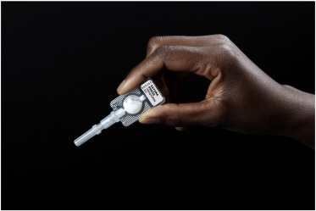
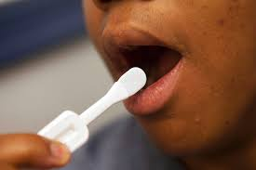

Implication #3: No more silos
ECHO has brought together FP and HIV worlds (in research, policy, and program). The connection cannot be lost.
The HIV world has much to learn from FP: many more decades of program experience, delivery at scale (58M+ in Africa, with many fewer resources), and simplified client-centered care.

Slide 31
Implication #4
STIs were too, too common.

Slide 32
Implication #4: STIs
STI prevalence and incidence were high in ECHO (Deese LBPEB16) … and in every other study recently among young women seeking HIV prevention in this setting (HPTN 082, POWER, ASPIRE, etc.).
New screening, treatment (partner treatment), and prevention strategies for STIs are needed.

Slide 33
Implication #5
Integration.
Women at the center.
Enough said.

Slide 34
Implication #5: Integration, women at the center
High-quality contraceptive services can be delivered in HIV contexts; HIV testing and prevention can be done in FP contexts. Trust women in making SRH decisions.
Women want HIV & FP services in the same room, same provider, same moment.

Slide 35
Thank you

Slide 36







Acknowledgements
The ECHO Consortium thanks the women who participated in this study for their motivation and dedication and the communities that supported this work. We are grateful to the members of the trial’s Data and Safety Monitoring Board, Global Community Advisory Group and local community advisory boards at each trial site, and overseeing ethics review committees for their expertise and guidance.
The ECHO Trial is dedicated to the memory of Dr. Ward Cates.
We are grateful to the ECHO funders:

